Slide 1

District and School Ratings in Texas
Avengers
Fall 2025
GROUP 2
Phuong Trinh
Harini Lingala
Sai Harshith Kondabathini
Mohamed Ahmed

Slide 2


Abstract
Goal 🎯:
Finding the best performing districts and schools in the state of Texas
Aim is to help families with children looking to move to the Lone Star State
Approach:
♟️Compared the Overall Rating (A, B, C, D, F) of schools in the state given features such as counties, region, district, size of district, the distinctions of each school, and more
🛠️ Modeling: Logistic Regression, LDA, Random Forest, XGBoost
📊 Evaluation: Compare outcome of models (Accuracy, Precision, AUC)

Slide 3
📚Why Districts and Schools Ratings?
👨‍👩‍👧‍👦 The education and growth of children is one of the most important things for parents
🏫 We analyzed the best schools given certain features to make it easy for parents to decide what school to enroll their kids in

Slide 4
Data Overview
🗂️ Collected from the Texas Education Agency (TEA) for the 2022-23 school year
📍 Consisted of over 10,000 schools and almost 1,000 districts
🔑 Key features:
District
County
Region
School type (Elementary, Middle, High)
Distinction Types
Charter
Overall Rating (target)

Slide 5
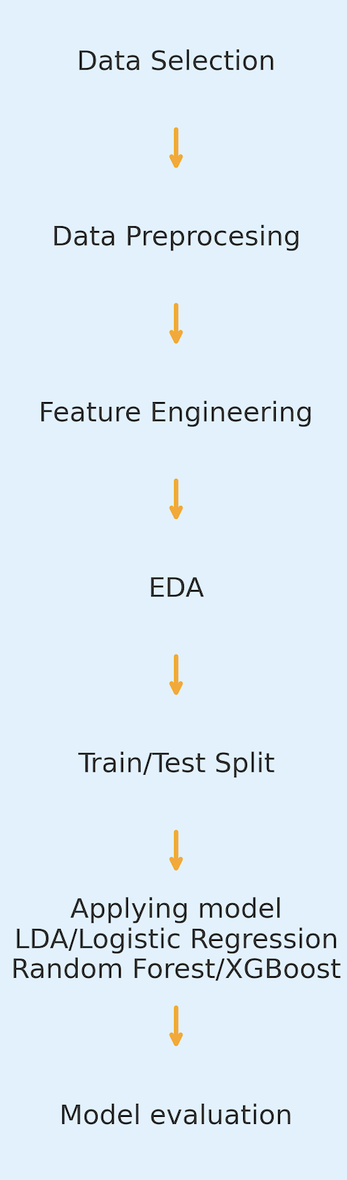

Workflow

Slide 6
Data Preprocessing
Removed columns with >80% missing values
Imputed remaining missing data (mean/mode) → 0 missing values
No duplicate rows found
Outliers detected (IQR) but kept as meaningful variation
Target variable (A–F) is slightly imbalanced but acceptable
Prepared categorical encoding; scaling will be applied during modeling

Slide 7

Exploratory Data Analysis
Power BI

Slide 8
Feature Engineering
Performance Gap Index • Measures inconsistency between Achievement/Progress vs Closing the Gaps • Larger gap → lower school performance stability
01
Achievement Efficiency Ratio • Captures how well a school performs relative to student size and economic disadvantage • Identifies schools "doing more with less"
02
Distinction Rate • Converts total distinctions into a normalized ratio (0–1 scale) • Higher rate → stronger academic recognition
03

Slide 9
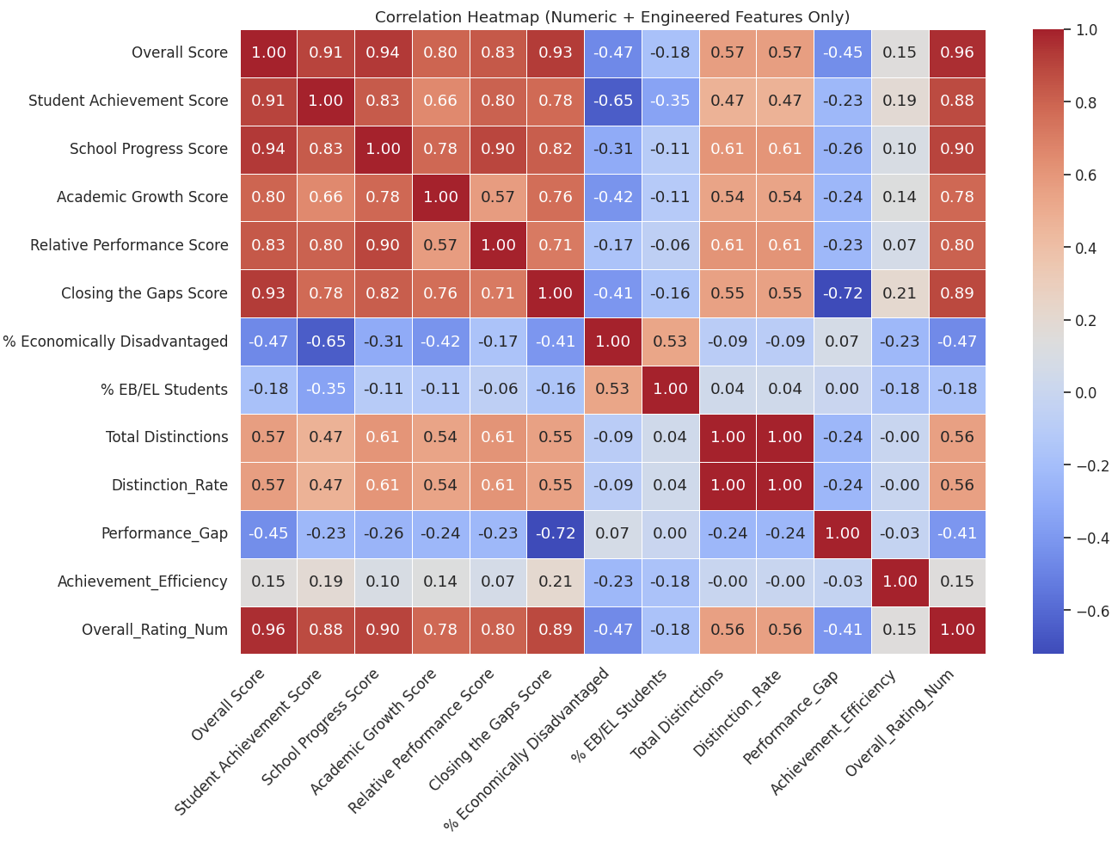
Feature Selection
Chose essential academic performance indicators (School Progress, Academic Growth, Closing the Gaps)
Added important demographic + distinction features (% Economically Disadvantaged, % EB/EL Students, Total Distinctions)
Included 3 engineered features (Performance Gap, Achievement Efficiency, Distinction Rate)
Final features selected using the correlation heatmap: • Strong correlation with the target (Overall Rating) • Low redundancy across predictors • High interpretability for modeling + reporting

Slide 10
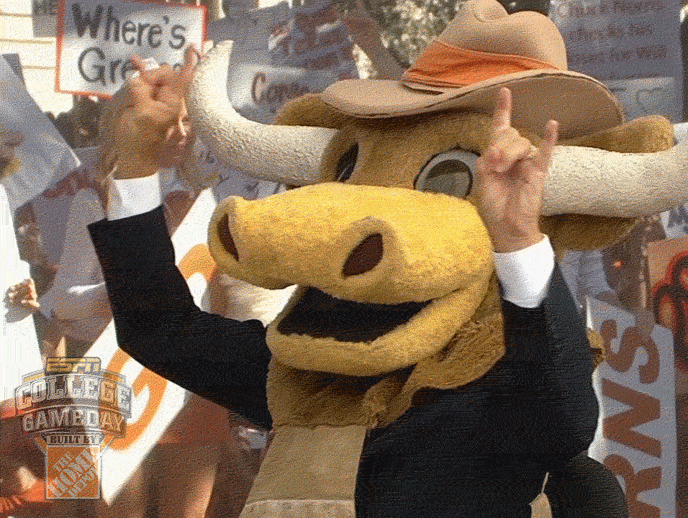
Machine Learning Models
Split data into training and testing sets (80/20)
Scaled the data
Confusion matrix
Roc Curve
Models Used:
LDA
Logistic Regression
Random Forest
XGBoost

Slide 11
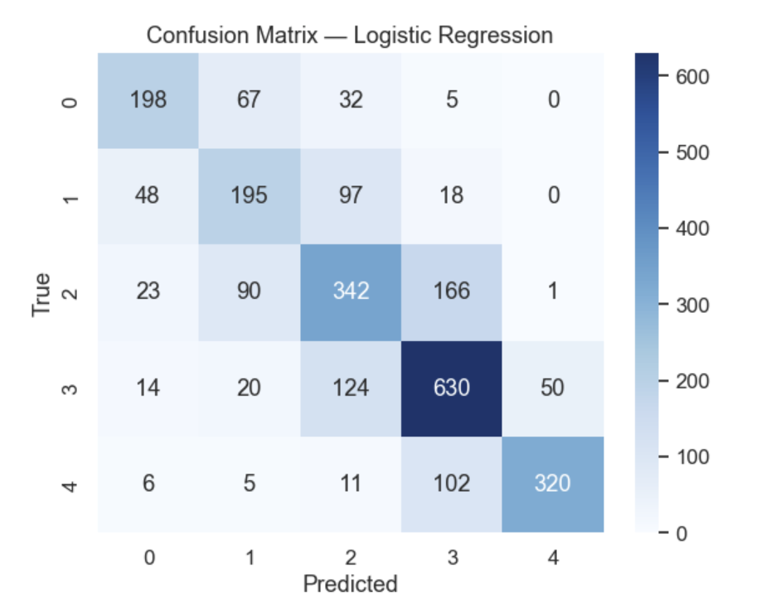
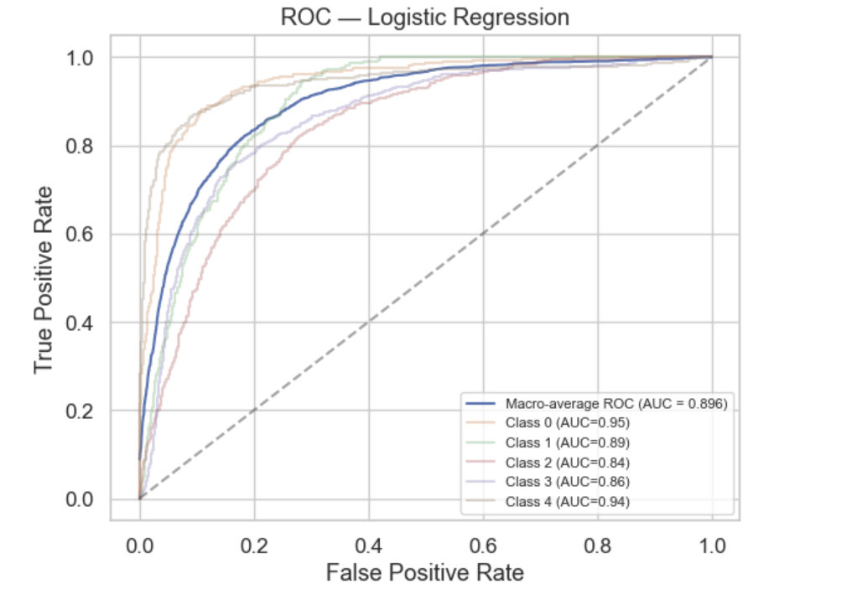
Logistic Regression
Accuracy: 66%
Works well for simple linear patterns
Struggles to separate similar classes (1, 2, 3)
AUC ~ 0.89(moderate class separation)

Slide 12
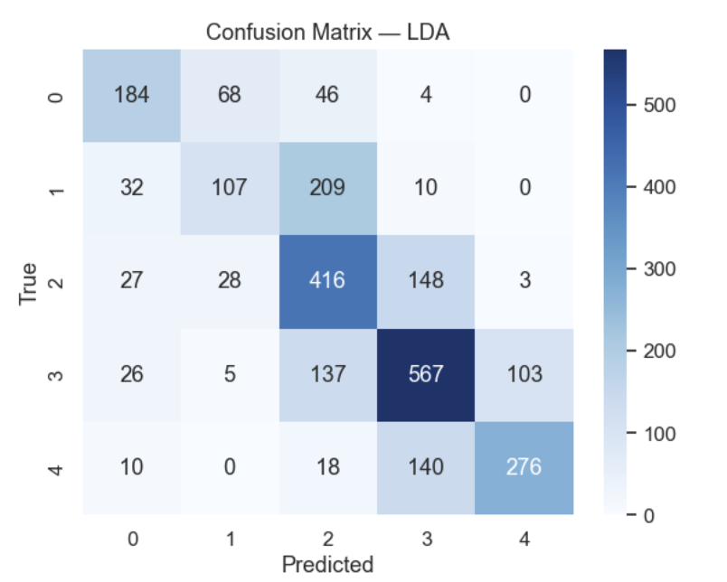
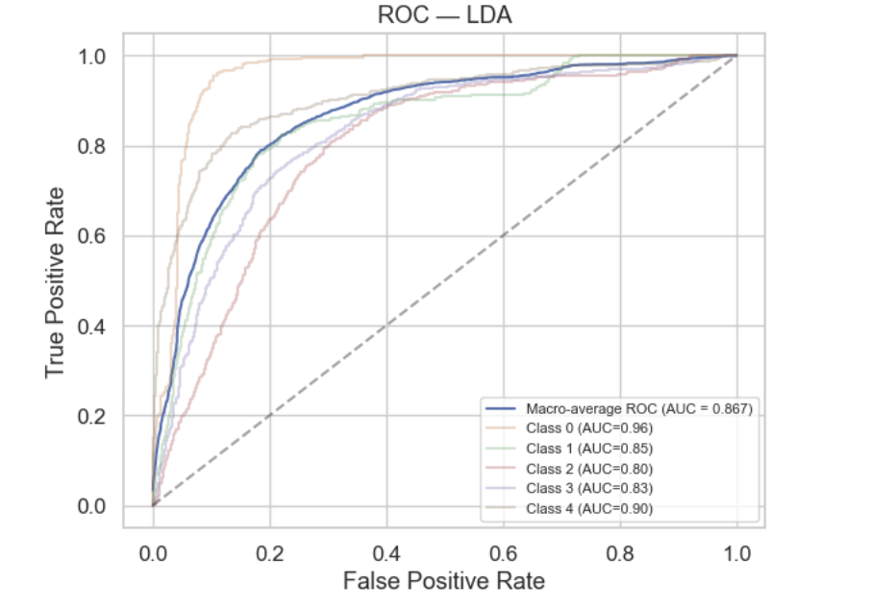
LDA
Accuracy: 60%
Struggles with non-linear boundaries
Better at distinguishing extreme classes (0 & 4)
AUC ~ 0.86

Slide 13
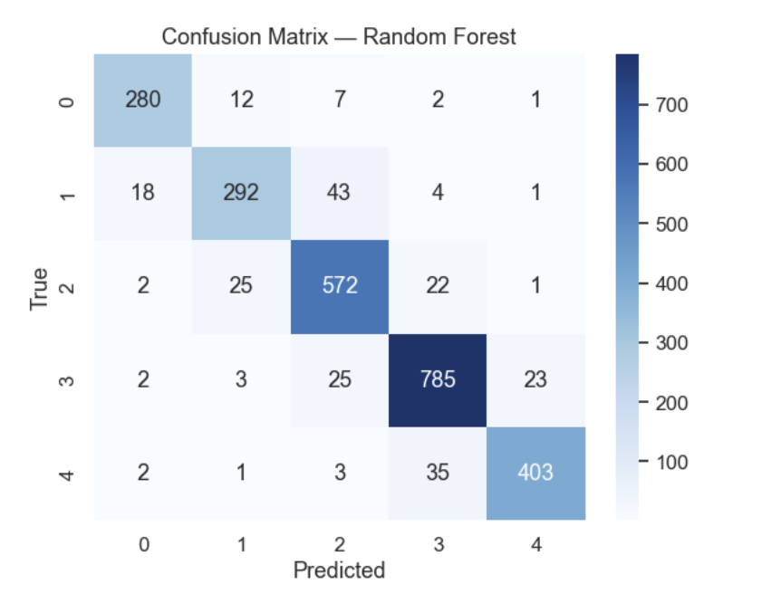
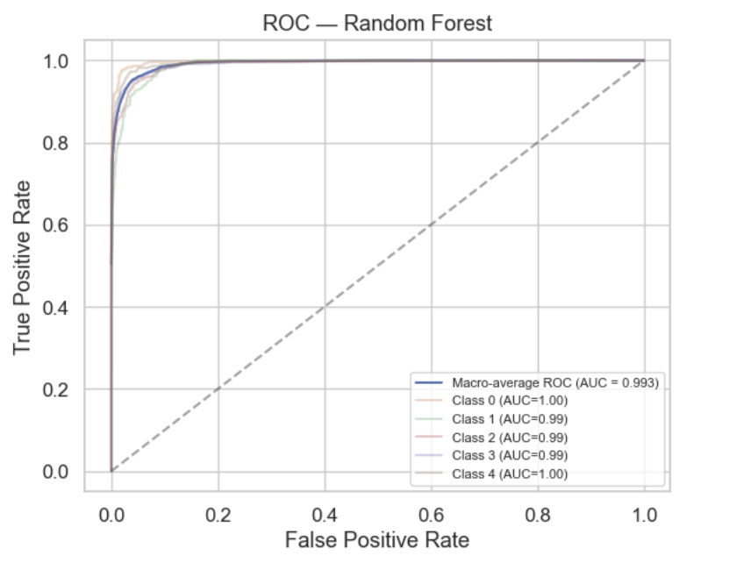
Random Forest
Accuracy: 91%
Very strong in capturing complex patterns
Low misclassification across all classes
AUC ~ 0.993

Slide 14
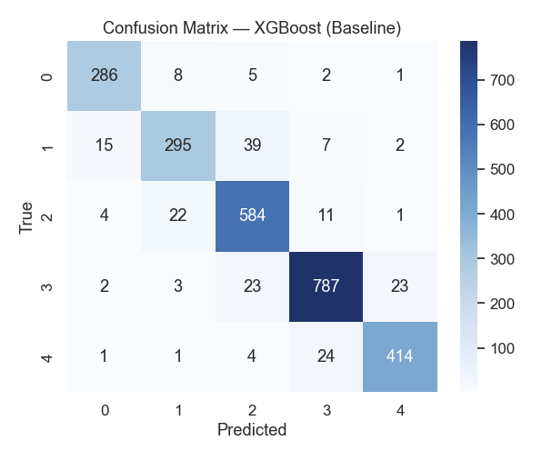
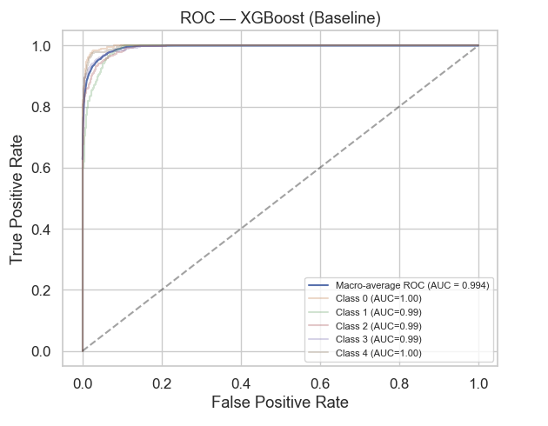
XG Boost
Accuracy: 92%
Most accurate model with very low errors
Excellent for handling mixed-type features
AUC ~ 0.994

Slide 15
WHICH MODELS IS THE BEST (CONCLUSION)
XGBoost performed the best overall
Highest accuracy (~ 92%)
Best macro F1-score (0.92)
Highest ROC–AUC (~ 0.99)
Consistently strong predictions across all classes
Random Forest was the second-best performer
Logistic Regression and LDA served as baseline models

Slide 16
FUTURE WORK
Perform hyperparameter tuning for Random Forest and XGBoost to further improve accuracy.
Use cross-validation to confirm the model's stability across different data samples.
Explore additional algorithms such as SVM, KNN, or Neural Networks to compare performance.
Conduct error analysis to understand which rating levels are most frequently misclassified.
Try PCA or other dimensionality-reduction techniques to simplify the model if needed.
Integrate the model outputs into the existing Power BI dashboard for automated model updates.
We can try adding more data to improve the model performance.

Slide 17

Thank You

